Slide 1
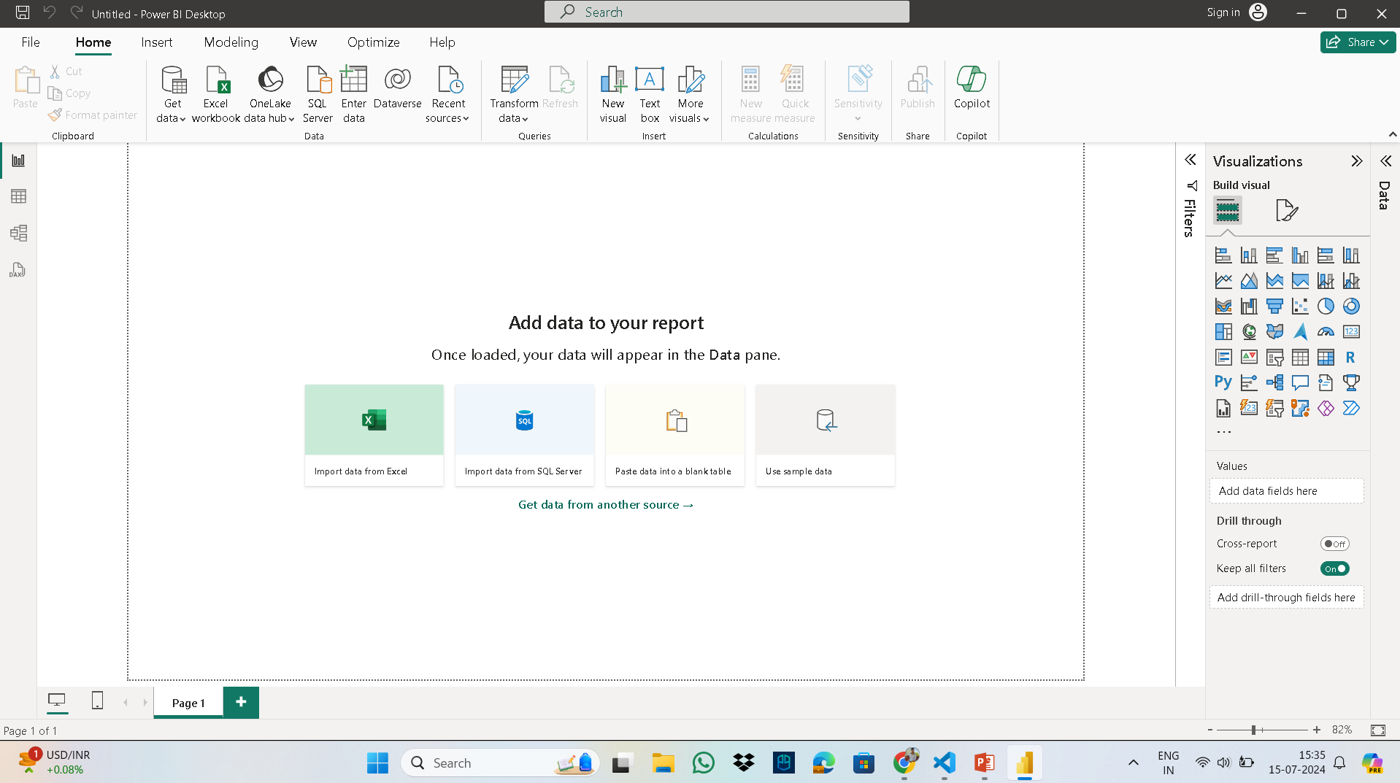
THIS IS THE VERSION YOU ALL ARE HAVING , IN WHICH NEITHER RIGHT CLICK IS WORKING NEITHRT THERE ARE RIBBONS FOR VISUAL.

Slide 2
CLICK ON FILE MENU

Slide 3
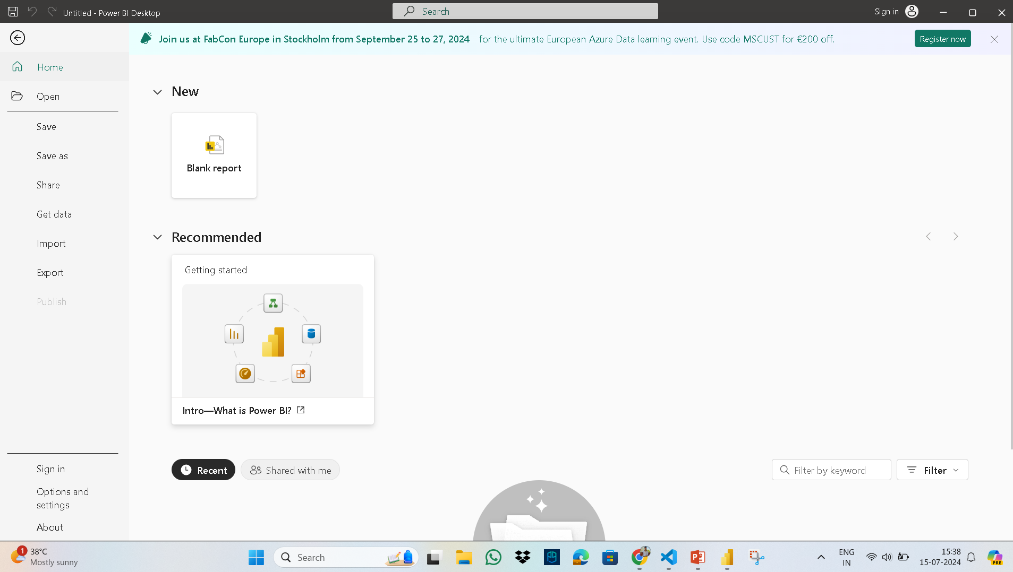
GO TO OPTIONS AND SETTNGS

Slide 4
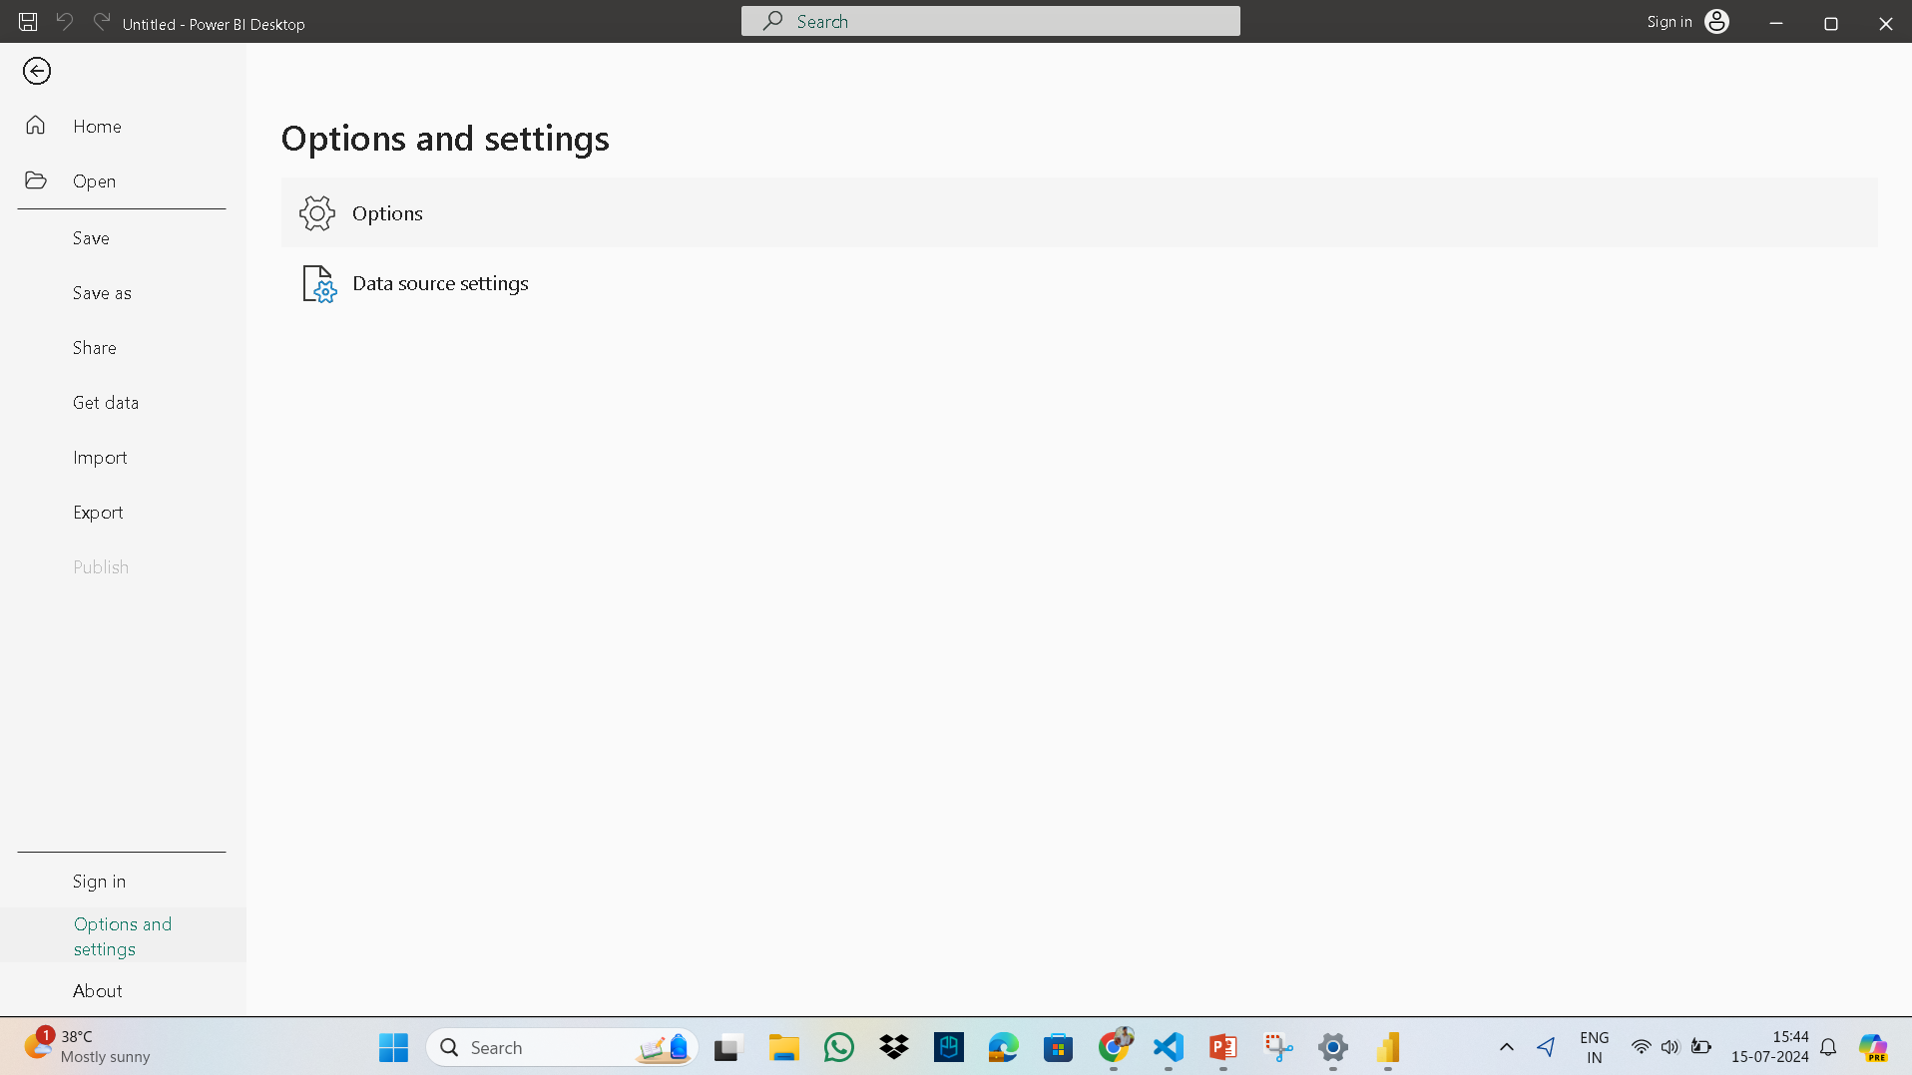
GO TO OPTIONS.

Slide 5
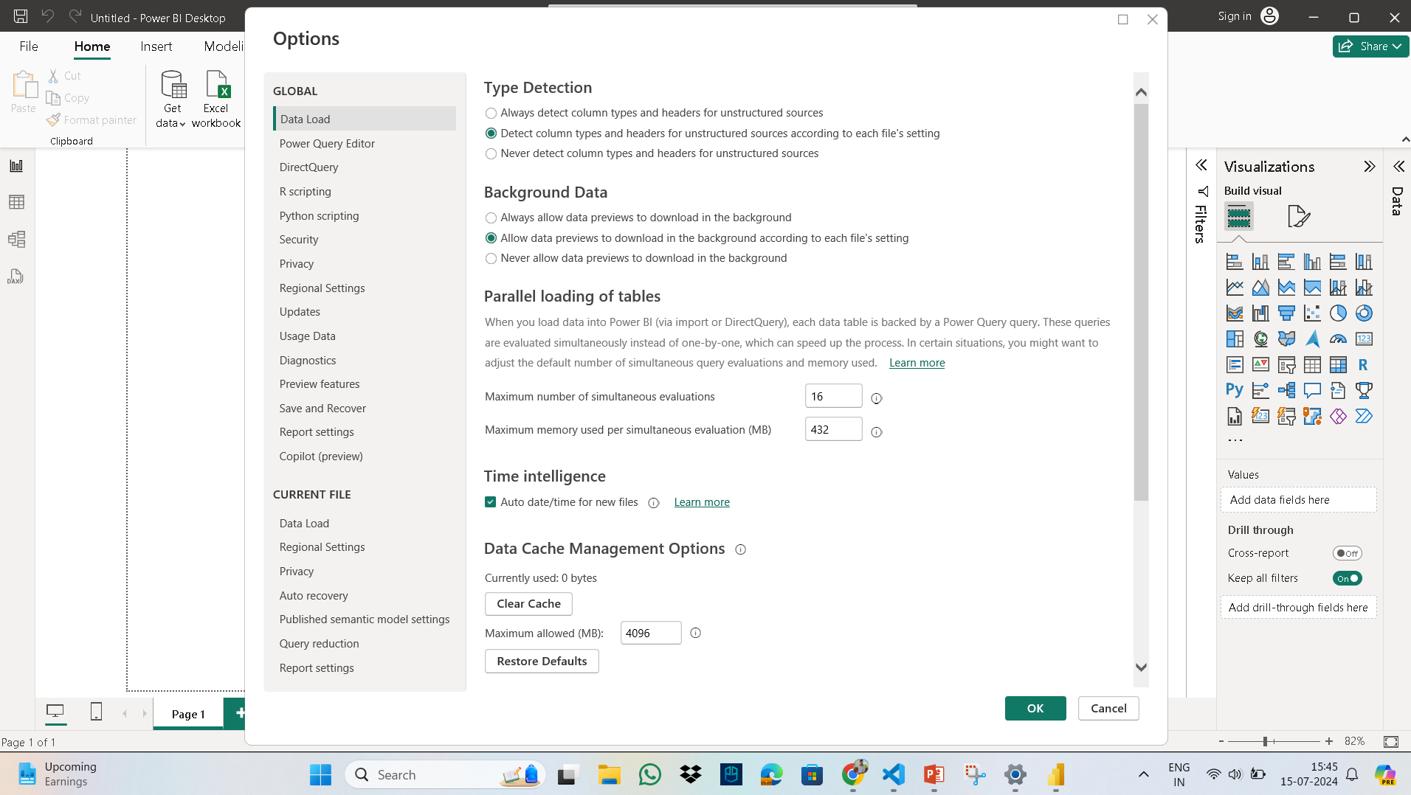
GO TO PREVIEW FEATURES.

Slide 6
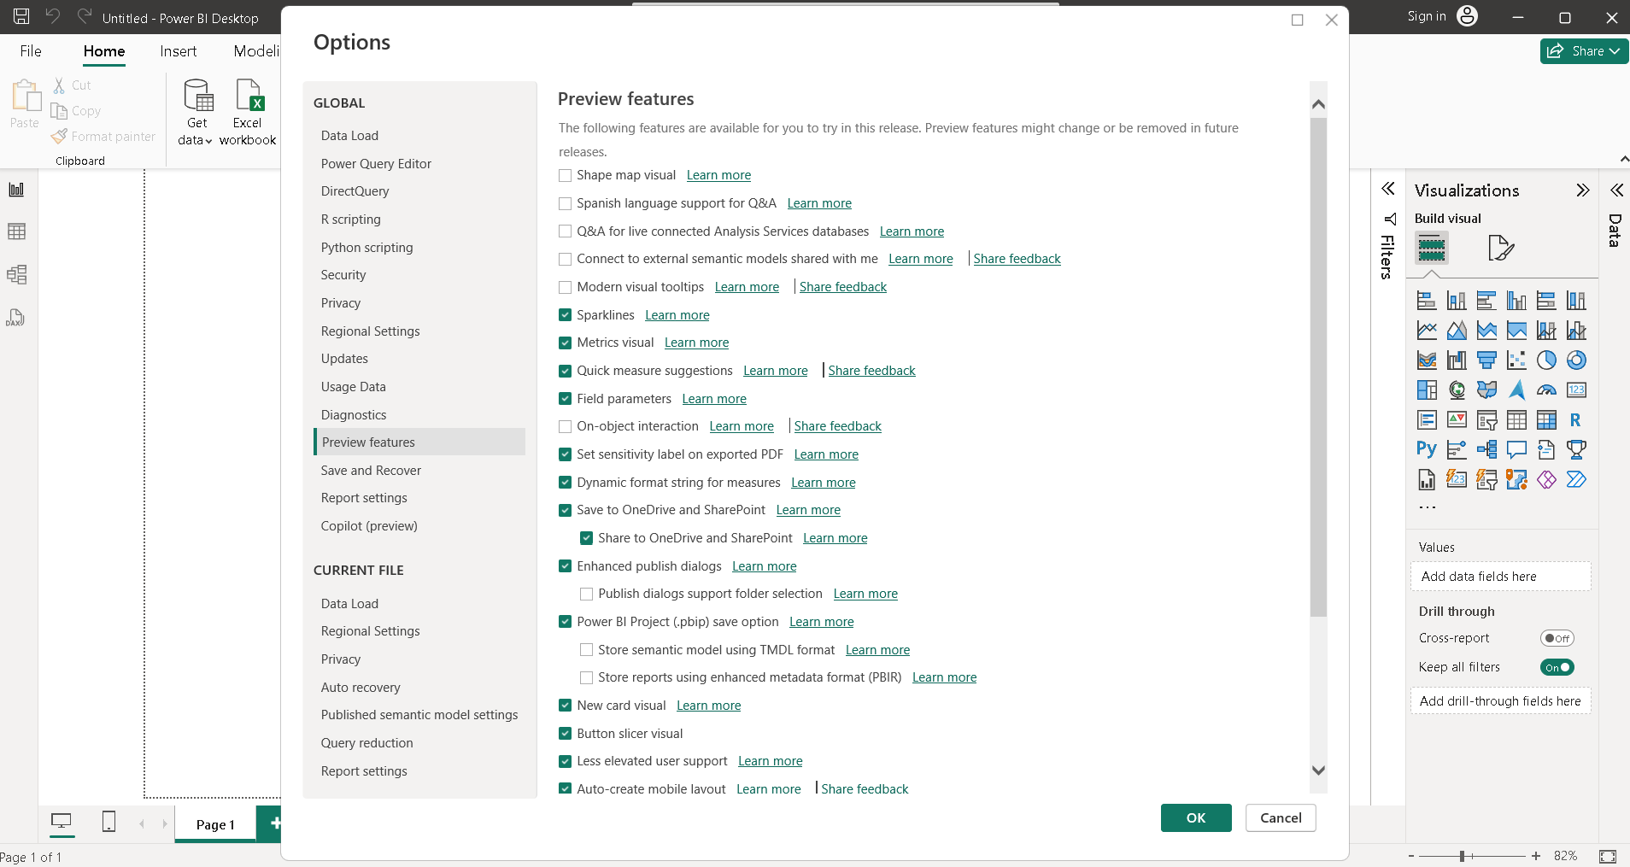
CHECK THE OPTION ON-OBJECT INTERACTION AND CLICK ON OK BUTTON.

Slide 7
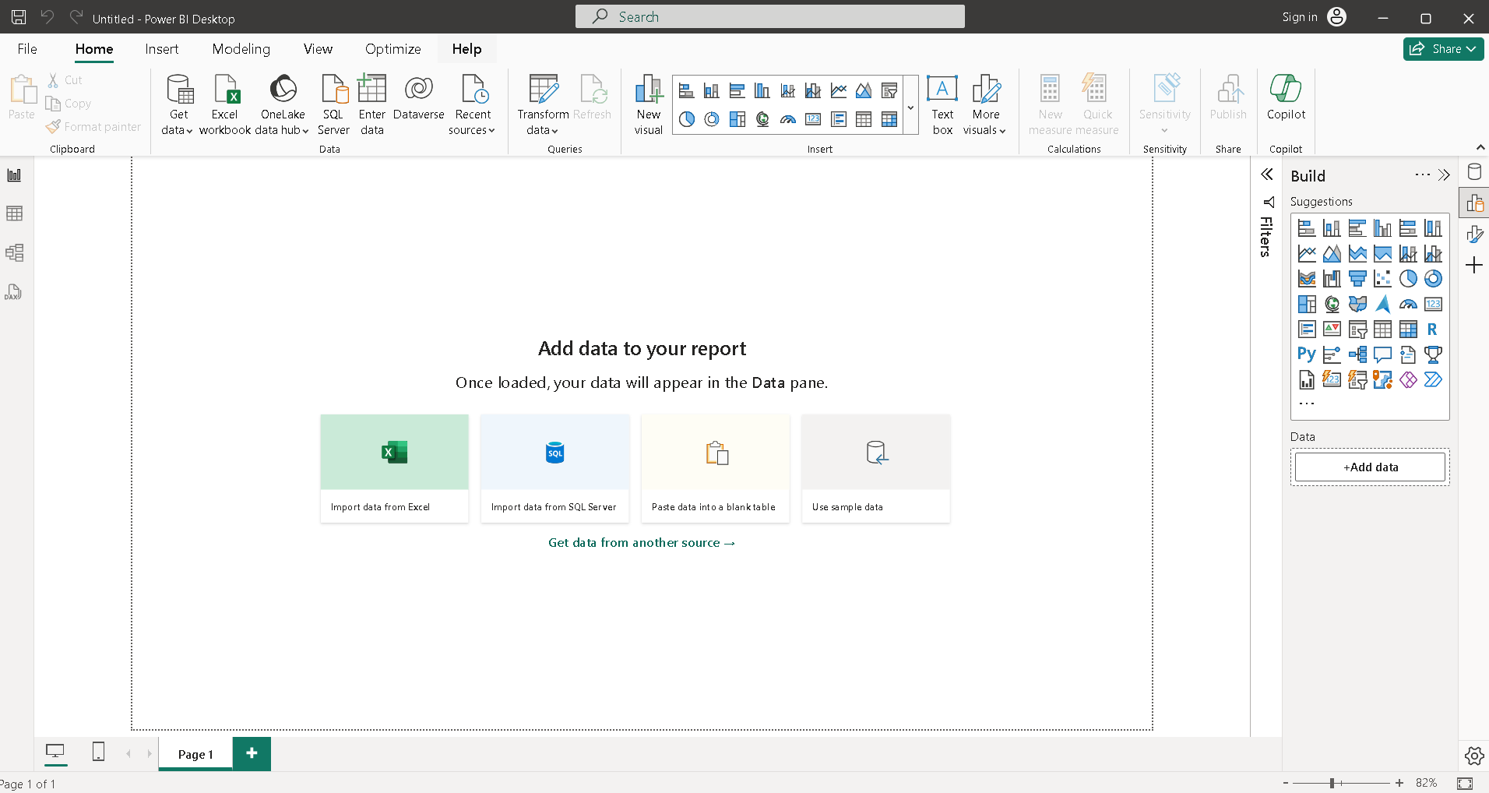
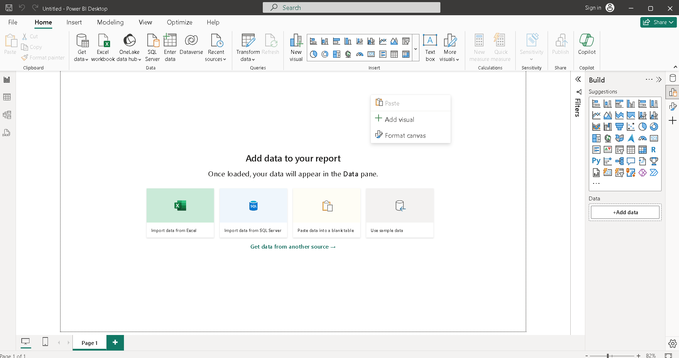
AFTER DOING ALL THE ABOVE TASKS RE-START YOUR SYSTEM.
THINGS WILL WORK OUT TO YOU.

